Slide 1
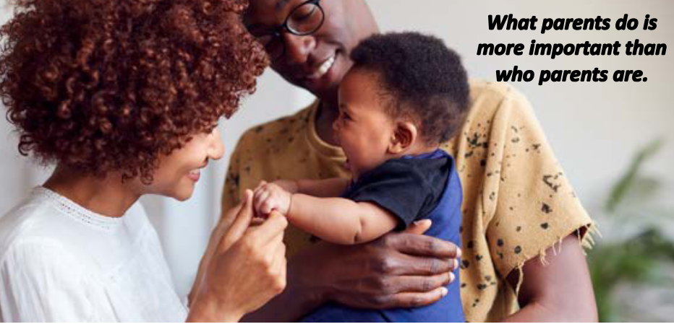
Best beginnings: caring for babies: bite-size CPD (September 2025)
What to expect in the EYFS: a parents’ guide
What-to-expect-in-the-EYFS-complete-FINAL-16.09-compressed.pdf

Slide 2
Caring for babies:
Section | Slide
Aim | 3
Did you know ..? | 4
Every baby needs these for a healthy life | 5
-Loving and nurturing relationships with parent carers | 6
-A safe home free from stress and adversity | 9
-The right help to develop good language and cognitive skills | 12
-Support to manage behaviour and regulate their emotions | 16
-Good physical and mental health | 19
Further information and useful websites | 22

Slide 3
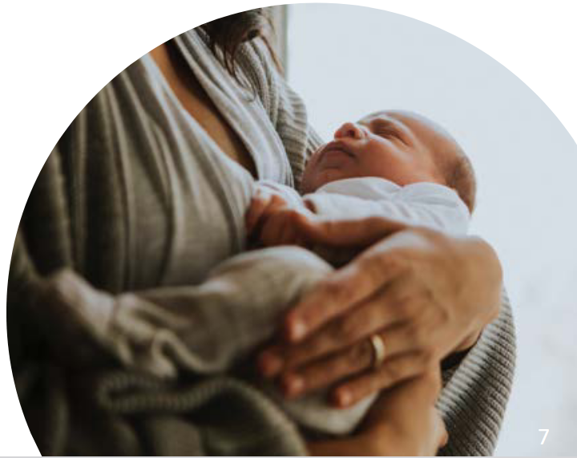
Aim:
To investigate the latest research and statutory guidance when creating safe, nurturing and supportive learning environments for babies.
What-to-expect-in-the-EYFS-complete-FINAL-16.09-compressed.pdf

Slide 4
Did you know..?
The building blocks for lifelong emotional and physical health are laid down in the period from conception to the age of two.
“Human babies are unique in the animal kingdom in the extent of their underdevelopment at birth. What other offspring is unable to walk until it is a year old, or fend for itself in any way until it is at least two years old? Those physical challenges are only the beginning; the human brain is itself only partially formed at birth and becomes hardwired by the baby’s earliest experiences, having a lifelong impact on their physical and emotional health.”
(2021:p.5)
The best start for life: a vision for the 1,001 critical days - GOV.UK

Slide 5

Every baby needs these for a healthy and happy life:
Loving and nurturing relationships with parent carers.
A safe home free from stress and adversity.
The right to develop good language and other cognitive skills.
Support to manage behaviour and regulate emotions.
Good physical and mental health and access to healthcare.
What-to-expect-in-the-EYFS-complete-FINAL-16.09-compressed.pdf
Best beginnings in the early years | Children's Commissioner for England

Slide 6
1. Loving and nurturing relationships with parent carers:
Babies are born to attach
They have a strong preference for human faces, seeking out eye contact and learning to smile at positive carers.
Attachment is a clinical term used to describe a "lasting psychological connectedness between human beings."
Children can form attachments with more than one caregiver, but the bond with the people who have provided close care from early infancy, is the most important and enduring.
Bowlby, John (1997) Attachment and loss. volume 1: attachment. London: Pimlico.

Slide 7
The key person
“Children need to build an attachment with their key person for their confidence and well-being. The key person also promotes children’s learning by developing a deep understanding of their individual needs and children can particularly benefit from their modelling and support. The requirements in relation to workforce training and responsibilities, including that of the key person, are outlined in Section 3 [EYFS statutory framework] but they are equally important for children’s learning and development as they are for their safety and welfare.”
(2025: p.12) Early years foundation stage statutory framework for childminders
(2025: p.17) EYFS statutory framework for group and school-based providers

Slide 8

Pause to read and reflect:
Attachment and the role of the key person – Birth To 5 Matters

Slide 9
2. A safe home free from stress and adversity:
“Adverse childhood experiences (ACEs) are traditionally understood as a set of 10 traumatic events or circumstances occurring before the age of 18 that have been shown through research to increase the risk of mental health problems and deliberating diseases.”
The 10 ACEs are:
1. Physical neglect | 6. Witnessing domestic abuse
2. Sexual abuse | 7. Having a close family member who misused drugs and alcohol
3. Psychological abuse | 8. Having a close family member with mental health problems
4. Physical neglect | 9. Having a close family member who served time in prison
5. Psychological neglect | 10. Parental separation or divorce on account of relationship breakdown
Improving the mental health of babies, children and young people: methodology,
literature review and stakeholder feedback that informed the framework - GOV.UK

Slide 10
“Exposure to prolonged, repeatedly harmful events or adversity from combined sources during childhood and adolescence, in the absence of nurturing relationships, impacts throughout life on many health and social outcomes including mental health and wellbeing.
Child adversity has been found to be associated with 45% of all child onset mental disorders and 26 to 32% of adult-onset mental disorders.”
Improving the mental health of babies, children and young people: methodology, literature review and stakeholder feedback that informed the framework - GOV.UK

Slide 11
Pause: watch and reflect:
How a child's brain develops through early experiences

Slide 12
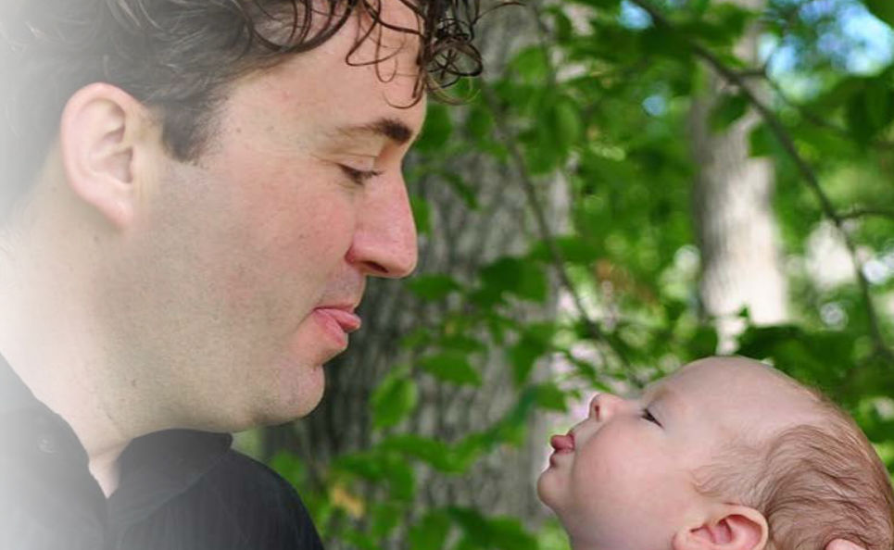
3. The right help to develop good language and other cognitive skills:
Supporting babies' early communication skills
Babies are amazing learners. They are born ready to learn about their home language or languages.
Here are some tips to support babies’ communication skills:
Be face to face: Babies learn a lot from looking at your face and body language when you talk. Make it easy for the baby by getting down onto the floor with them and being face to face.
Take turns: Copy the sounds and actions that the baby makes. If the baby says ‘ga’- you say ‘ga’ back.
What-to-expect-in-the-EYFS-complete-FINAL-16.09-compressed.pdf
Resource library for educators - Speech and Language UK:
Changing young lives

Slide 13

3. The right help to develop good language and other cognitive skills:
Watch closely: What is the baby doing or looking at? Watching the baby closely can help you know when they are ready to hear a new word, and when they are busy thinking and don’t want to be interrupted!
Repeat words: Babies need to hear words lots of times before they can understand the words or use them to talk. Keep your sentences short and say important words several times- ‘Shoes. Your shoes. Red shoes. Bye-bye shoes’.
Choices: Even before babies can talk, they can often find other ways to communicate what they want if given a choice. Show the baby two things to choose between (e.g. ‘teddy or ball?’, or ‘apple or banana?’). They may show you by looking, reaching, pointing, or by trying to say the word.
What-to-expect-in-the-EYFS-complete-FINAL-16.09-compressed.pdf
Resource library for educators - Speech and Language UK:
Changing young lives

Slide 14
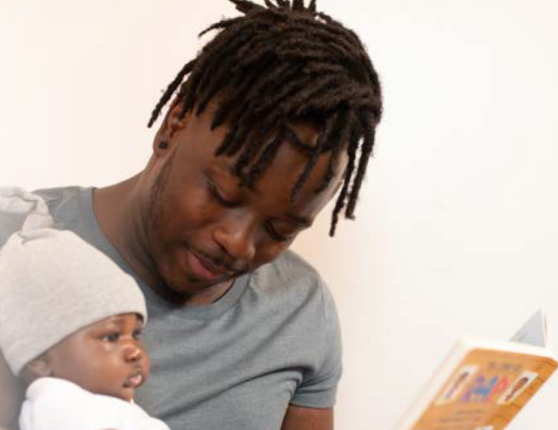
3. The right help to develop good language and other cognitive skills:
People play: Babies learn to communicate best by spending time playing and communicating with other people. Find more ideas at People games - Resource Library - Sheffield Children's NHS Foundation Trust
Songs, nursery rhymes, and music: Babies can learn words and actions through songs and nursery rhymes. Share songs, nursery rhymes, and music with your child in any of the languages that you use at home.
Share stories: Looking at books together is a great way to help babies and toddlers learn new words. Start by simply talking about the pictures that the child seems interested in.
Resource library for educators - Speech and Language UK: Changing young lives
What-to-expect-in-the-EYFS-complete-FINAL-16.09-compressed.pdf

Slide 15
Pause: read and reflect:
https://www.bbc.co.uk/tiny-happy-people/baby-development

Slide 16
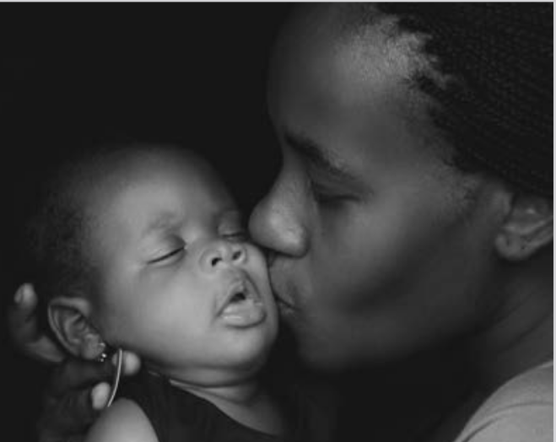
4. Support to manage behaviour and regulate their emotions:
"We know that children who at an early age can manage their own emotions and behaviour go on to have much better outcomes later in life. Babies and very young children cannot regulate their emotions alone and so need help from parents and carers to do so – which in turn helps them learn to regulate their emotions independently.
Evidence shows that children who are less able to control their feelings and behaviour in the early years are more likely to have worse long-term outcomes – for example they are more likely to struggle in education; children with poorer socio-emotional skills at age ten are more likely to be unemployed, and to have a criminal conviction, by the time they are adults.“
cco-best-beginnings-in-the-early-years.pdf
What-to-expect-in-the-EYFS-complete-FINAL-16.09-compressed.pdf

Slide 17
Create a calming, emotional environment:
Observe babies' emotional responses and plan the routines, the environment and play experiences to support them.
• Encourage parents / carers to bring their baby's comforter / transitional object to ease the change from home to setting.
• Create a cosy, quiet place for babies to be calm.
• Provide comfortable seating such as a sofa or cushions for baby and key person to be together.
• Create spaces and experiences in which babies feel secure enough to explore and play.
• Provide resources including picture books and stories that focus on a range of emotions.
Communicate with parents / carers daily to ensure continuity of care between home and the setting.
(2021: p.62)
Birthto5Matters-download.pdf

Slide 18
Pause: read and reflect:
Help for early years providers : Mental health for early years children

Slide 19

5. Good physical and mental health and access to healthcare:
“Good health is a vital foundation for later life... Good mental health is just as essential and will depend on all five of these building blocks being in place.
What this evidence shows is that the environment and care a child has in their earliest years, and the early indicators of their health, socio-emotional well-being and cognitive development all make a difference to how well they do later in life. If we want to see children doing better at school, forming healthy relationships, and having good mental health and well-being all this suggests that we need to be helping children and investing very early on.”
(2020: p.9)
cco-best-beginnings-in-the-early-years.pdf
What-to-expect-in-the-EYFS-complete-FINAL-16.09-compressed.pdf

Slide 20
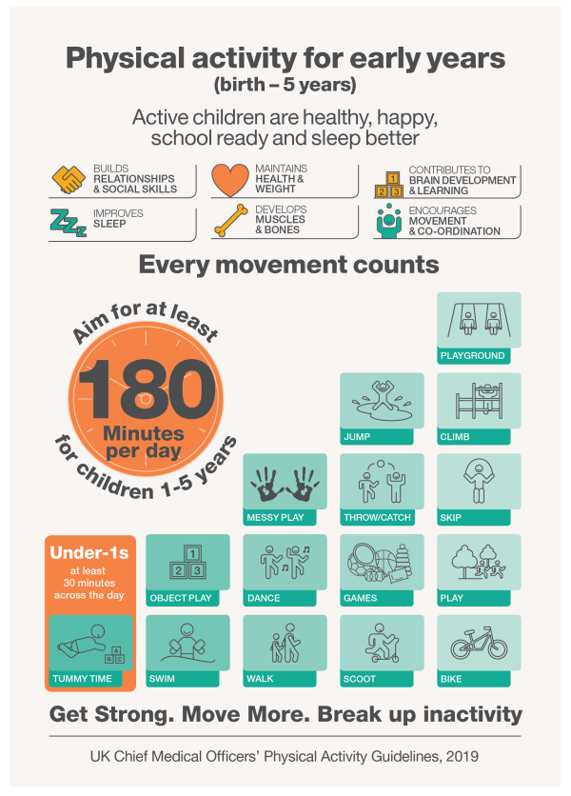
Physical guidelines for babies:
Infants (less than 1 year) should be physically active several times every day in a variety of ways, including interactive floor-based activity e.g. crawling.
For infants not yet mobile, this includes at least 30 minutes of tummy time spread throughout the day while awake (and other movements such as reaching and grasping, pushing and pulling themselves independently, or rolling over); more is better!
UK Chief Medical Officers' Physical Activity Guidelines

Slide 21
Pause: read and reflect:
https://www.nhs.uk/start-for-life/baby/baby-moves/#tummy

Slide 22
Further information and useful websites:
Bottle feeding and sterilising
Bottle feeding advice – NHS
How I learn and grow
How I learn and grow | Shropshire Council
Know how guide working with under 2’s (September 2025)
know-how-guide-working-with-under-2_sept_2025.pdf
Nappy changing
How to change your baby's nappy – NHS
Preventing and controlling infections - GOV.UK
Safer sleeping
Safer sleep overview | The Lullaby Trust
Car seats | The Lullaby Trust
The baby room: a practical guide for early years educators
https://www.communityplaythings.co.uk/learning-library/training-resources/the-baby-room

Slide 23
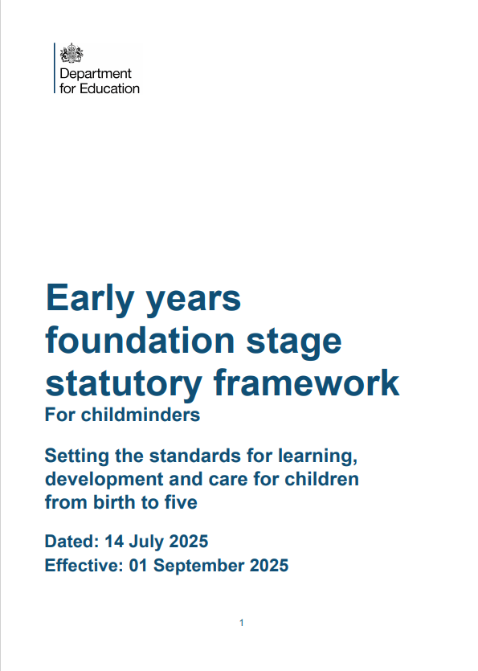
Early years foundation stage (EYFS) statutory framework - GOV.UK

