Slide 1
The Prevent Duty = Safeguarding
Since July 2015 all schools and registered childcare providers (settings) are subject to the Prevent Duty: “to have due regard to the need to prevent people from being radicalised into terrorism”.
Promote fundamental British Values as part of the settings values and curriculum (see curriculum resource examples at Teaching children how to keep themselves and others safe | Shropshire Learning Gateway).
Ensure settings are a “safe space” for children to understand and discuss sensitive topics, including those linked to terrorism and extremism, and learn how to challenge these ideas in a politically balanced way (including developing critical thinking skills)
Conduct a risk assessment of how children and staff may be susceptible to being radicalised into terrorism, including online; drawing on the potential risk in the local area.
Ensure the setting’s filtering and monitoring systems are informed by the risk assessment above (see Meeting digital and technology standards in schools and colleges - Filtering and monitoring)
Ensuring policies outline how the setting safeguards learners who are susceptible to radicalisation into terrorism and align with local safeguarding arrangements.
Ensure all staff are trained to safeguard children who are susceptible to radicalisation into terrorism (concerns should be reported to the DSL).
Governing Bodies/Heads/Designated Safeguarding Leads/Prevent Leads should work to:
Prevent duty guidance: for England and Wales
The Prevent duty: safeguarding learners vulnerable to radicalisation.
See also Regional Prevent education co-ordinators guidance and sign up for Newsletter
Notes:
Counter Terrorism and Security Act
Preventing children from being drawn into terrorism is safeguarding and promoting their welfare.
Policies would not only include Child Protection Policy, but also Behaviour Policy, PSHE/RSHE, E-Safety, Staff Behaviour/Code of Conduct.

Slide 2

What is the Prevent Duty?
Section 26 of the Counter-Terrorism and Security Act 2015 places a duty on certain “specified authorities” to have “due regard to the need to prevent people from being drawn into terrorism”
Revised Prevent duty guidance: for England and Wales - GOV.UK (www.gov.uk)
What is the Prevent Programme? This is about early intervention to address the personal and social factors which make people more vulnerable to being drawn into terrorism.
Its aim is to divert people away from being drawn into violent ideologies and criminal behaviour that could harm themselves or others.
What is Channel Panel?
The panel is a multi-agency group to identify and provide early support to individuals who are at risk of being drawn into terrorism or supporting terrorist organisations, regardless of age, faith, ethnicity or background.
For more information about Prevent go to:
ACT Early | Prevent radicalisation
How do I get support for myself or someone else?
To make a referral. Please send your completed form to:
ctu_gateway@westmidlands.police.uk
You can find the form here:
https://shropshire.gov.uk/media/22210/prevent-national-referral-form-v31.docx
Who is vulnerable to radicalisation?
There are no set profiles but look for:
A desire for status
A desire for political or moral change
A need for identity, meaning and belonging
Mental health issues
Someone feeling under threat
A desire for excitement and adventure
What is the risk in Shropshire?
The Right Wing and Islamist threats remain the highest priorities for Shropshire.
Right-Wing activity has begun to emerge and the majority of referrals are about this type of
extremism. Although it remains sporadic in nature, it is thought there is a level of under reporting of graffiti and stickering attributed to both White Supremacism and White Nationalism.
What types of ideology are there? Extremists could belong to any of the groups below and are those who believe violence is needed to make their point
The far right
Faith-claimed extremists
Mixed, unclear and unstable Ideologies
Northern Ireland-related terrorism
Involuntary celibates
The left wing
Animal rights and environmental extremists
What are the signs someone is being radicalised?
People may display some, all or none of the signs but look out for:
Use of discriminatory language
Change of appearance
New and lost friendships
Withdrawal
New found arrogance
Preventing Terrorism in Shropshire
Understanding PREVENT and Channel Panel
January 2022
Preventing Terrorism in Shropshire — Shropshire Safeguarding Community Partnership

Slide 3
Key Terms: Radicalisation, Extremism & Terrorism: Keeping children safe in education: Annex B: Preventing Terrorism
Radicalisation
The process of a person legitimising support for, or use of terrorist violence
Extremism
New definition in 2024 but only for UK ministerial central government departments!
Terrorism
The Department for Education (DfE) are not currently asking any education settings to adopt the definition or apply the principles. The “Preventing Radicalisation” section in KCSIE 2024 remains under review.
- Continue to follow statutory guidance
- Actively promote fundamental British Values (democracy, the rule of law, individual liberty, and mutual respect and tolerance for those of different faiths and beliefs). Ofsted inspects how well schools and colleges promote these values
An action or threat designed to influence the government or intimidate the public. Its purpose is to advance a political, religious or ideological cause.

Slide 4
Heads/DSLs/Prevent Leads must complete and should share with the Governing Body a risk assessment of how children and staff may be at risk of being susceptible to radicalisation into terrorism.
Prevent Risk Assessment
Leadership understanding and shared responsibility
Effective partnership working (including understanding the local profile of risk)
Competent and aware staff
Effective information sharing and appropriate referrals
Building children’s resilience to radicalisation.
Ensuring effective online safety (including effective filtering and monitoring)
Managing visitors (including external speakers and use of school site)

Slide 5
CTLP (Counter Terrorism Local Profile)
The current UK threat is substantial, meaning an attack is likely.
Further national information and data:
Threat Levels | MI5 - The Security Service
Data on the use of Police powers is regularly shared at Counter-terrorism: Research and Statistics
A maintained list of: Proscribed terrorist groups or organisations
Data on: Individuals referred to and supported through the Prevent Programme statistics
You can request information regarding your local CTLP threat by contacting Jane Parsons (Jane.Parsons@shropshire.gov.uk ).

Slide 6
Prevent Training: Everyone in school should complete Prevent Training appropriate to their role.
Online Home Office Training can be accessed via: Prevent duty training: Learn how to support people susceptible to radicalisation | Prevent duty training.
All staff should complete awareness level training on induction and then refresh annually.
Governor-specific training (recommended for at least the Chair/Safeguarding Link Governor) can be accessed from Regional Prevent education co-ordinators - GOV.UK
Leads with designated Prevent responsibilities (including DSLs): In addition to staff training; should complete training on induction and then as a minimum every 2 years. Training should include:
An understanding of when and how to make Prevent Referrals and the purpose of the Channel /Prevent Multi-Agency Panel (by completion of Home Office modules).
Information on extremist and terrorist ideologies to enable them to train and advise other staff and support making informed referrals to Prevent where necessary. Shropshire recommend that this is completed by:
Attending a DSL sector specific DfE Prevent in Education for DSLs Training; available at: Regional Prevent education co-ordinators - GOV.UK
Signing up to Regional Prevent in Education Newsletter. The most recent newsletter (September 2025 included links to DfE London RPEC Training Links | Linktree, to access the following training: introduction to incels, online platforms and extremist content session, and a gaming and extremism session)
Further resources at: Educate Against Hate - Prevent Radicalisation & Extremism.
Further specific training and resources for schools (including Prevent Quizzes for staff) at: The Prevent Duty | London Grid For Learning

Slide 7
Key Local Contacts and Links:
Shropshire Council’s Prevent Lead is Rachel Robinson.
For any Prevent related queries, please contact: SSCPbusinessunit@shropshire.gov.uk
Channel Panel Chair
Cezar.Sarbu@shropshire.gov.uk
Channel Panel Vice Chair,
Jane.rose@shropshire.gov.uk
Channel Panel representative Learning and Skills
Jane.Parsons@shropshire.gov.uk
West Mercia Police Prevent Engagement Officer:
prevent@westmercia.police.uk
01386 591815
West Midlands Regional Prevent Co-Ordinator
Alamgir.sheriyar@education.gov.uk.
Prevent Referrals and Advice
Guidance and Tools:
Local: West Mids procedures - Radicalisation, terrorist and extremist ideology
National: Managing risk of radicalisation in your education setting and Making a referral to Prevent
Referrals:
Referral forms can be found at: The Prevent Duty (Preventing Terrorism) | Shropshire Learning Gateway
Alternatively, you can report via the West Mercia website West Mercia Police.
DfE Regional Prevent Updates:
Sign up for the Newsletter
Advice:
If uncertain about whether threshold is met for a Prevent referral, contact West Mercia Police on 01386 591821 for a consultation
For assistance with completion of a Prevent referral form, contact the West Midlands Prevent hub 0121 251 0241.

Slide 8


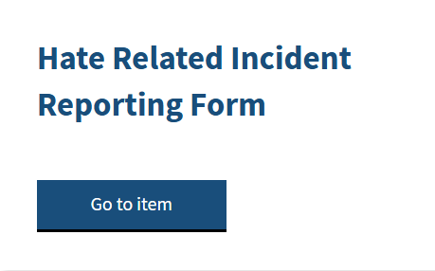


Preventing and Responding to hate-related behaviour helps to prevent radicalisation.
Hate-related behaviour =
behaviour by a one person towards another (child or adult)
Perceived by the child or adult experiencing the behaviour or anyone else to be
Prejudice towards them because of their race, religion, sexual orientation, disability or because they are transgender (one of the Equality Act 2010 protected characteristics).
Recognise hate related behaviour but always follow the Prevent pathway where appropriate.
Find out more at: What is Hate Crime? - True Vision
You will also need to consider whether to notify Police: Use When-to-call-the-police--guidance-for-schools-and-colleges to help you.
Find out more about the i am Me! Programme at: The Prevent Duty (Preventing Terrorism) | Shropshire Learning Gateway
Find out more about the local Hate-related incident reporting process
Notes:
Relevant or concerning behaviours/indicators:
A significant change in discriminatory views or use of language: where is the child getting this from?
Closed to challenge
Fixated on topic or group
Expression of /Interest in views/groups actively opposed to British Values
“Them and Us” Language
Support for/legitimisation of violence towards a particular group
It is vital that to promote and ensure British Values of mutual respect and tolerance and ensure that all children and staff working in school regardless of who they are or where they are from are protected from hate based language, behaviour and abuse. Please ensure that you ensure that your CP Policy/Behaviour/Preventing Terrorism Policy includes your response to hate related incidents and the incident reporting process (form on LG). This will most likely be reflected in your behaviour policy; as well as your school approach to child-on-child abuse and prevent.
I am Me! Programme:
The leaflet attached in SLG gives details about the I am ME! Project. The main aim is to raise awareness about hate crime, the impact, the consequences and how to get support. Education is key in tackling hate in our communities. The sessions delivered are interactive and fun and also free of charge. We tailor our sessions for different audiences and age groups so happy to discuss your school’s requirements. Please contact TrainingWestMercia@victimsupport.org.uk if you would like to discuss this further or arrange some sessions for your school.

Slide 9
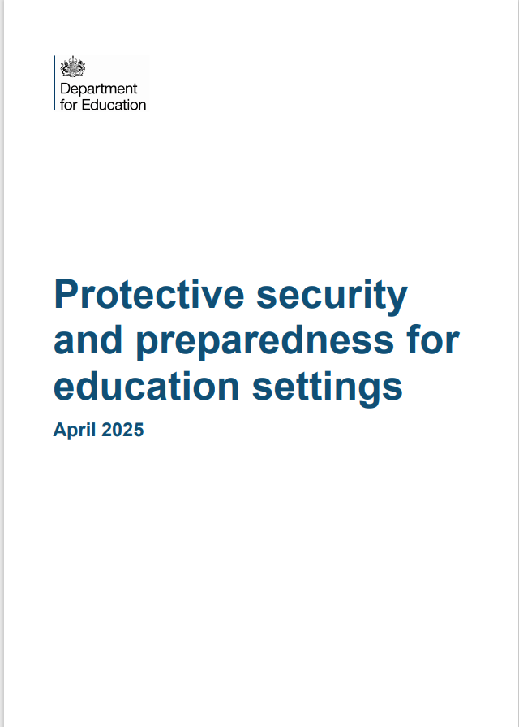

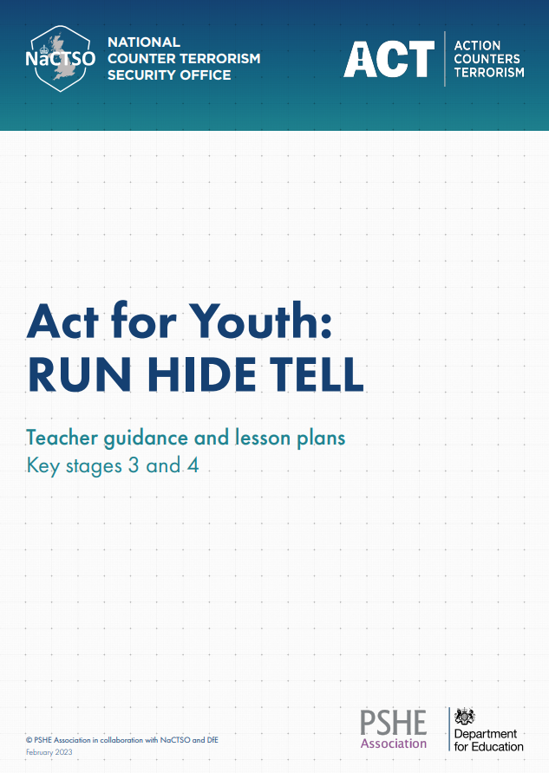
Ensuring a Safe school: Protective Security and Preparedness (updated April 2025)
Guidance, templates (including self assessment) and training to help keep learners, staff and visitors stay safe on the school site by ensuring:
Plans are in place to reduce the risk of terrorist incidents and other incidents by making it difficult for someone intending to cause harm to target their sites.
Plans are in place to respond effectively to different types of incidents.
There is regular testing of the plans to make sure they are suitable and effective (including ensuring additional support for those who are particularly vulnerable).
How Martyn’s Law will affect education settings - GOV.UK
ACT for Education | National Counter Terrorism Security Office (NaCTSO)
Notes:
Terrorism (Protection of Premises) Act 2025: aka “Martyn’s Law” Received Royal Assent on 3.4.2025 and is now law. However there is an implementation period of 24 months before the act comes into force.
Requires those responsible for certain premises and events to take steps to mitigate the impact of a terrorist attack and reduce harm in the event of an attack occurring. It will affect education settings - Early Years, primary, secondary and further education settings are considered to be 'standard tier' duty premises under the Act.

